Slide 1

Common Ground Online
Redesigning Systems. Together.
Unity 6 | Multiplayer | AI-Driven NPCs
Notes:
Common Ground Online is a cooperative multiplayer role-playing game built in Unity 6 that reimagines how we understand accessibility. Instead of centering disability as individual limitation, the game positions exclusion as a failure of design. Players work together inside a shared fantasy world to identify and redesign systems that unintentionally exclude others.

Slide 2
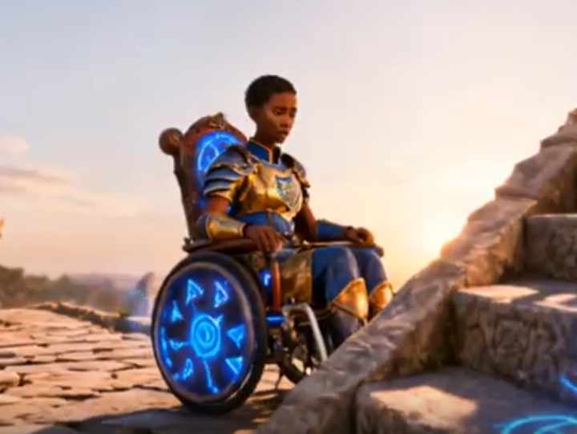
The Problem
Accessibility is often treated as accommodation.
  Ableism is embedded in systems.
  Most games reinforce individual heroism.
  Few experiences simulate systemic redesign.
Notes:
Accessibility is often treated as accommodation—an afterthought added to systems built for a narrow norm. As a result, exclusion becomes invisible to those not directly impacted. Few experiences expose the structural conditions that produce exclusion. Common Ground Online makes systemic barriers visible, interactive, and collaboratively solvable.

Slide 3
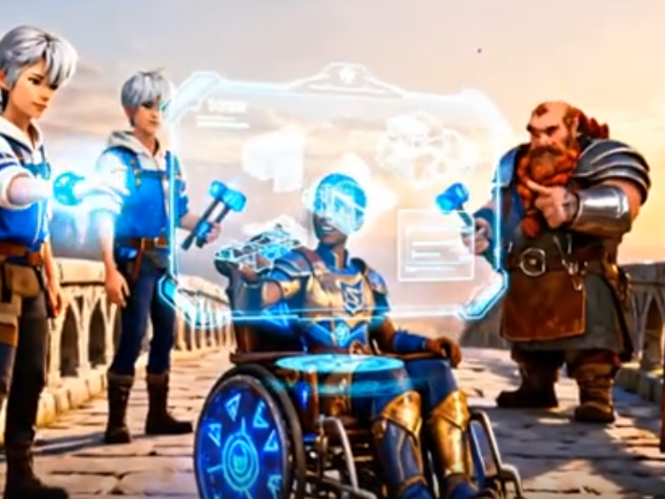
The Solution
2–4 player cooperative MMORPG
  Navigation-first mechanics
  AI-responsive NPCs
  Role-gated systemic redesign
Notes:
Common Ground Online is a 2–4 player cooperative MMORPG designed around navigation-first mechanics. Players encounter barriers embedded in the environment. AI-driven NPCs respond dynamically to player actions, tracking trust and emotional state. Progress depends on collaborative redesign.

Slide 4
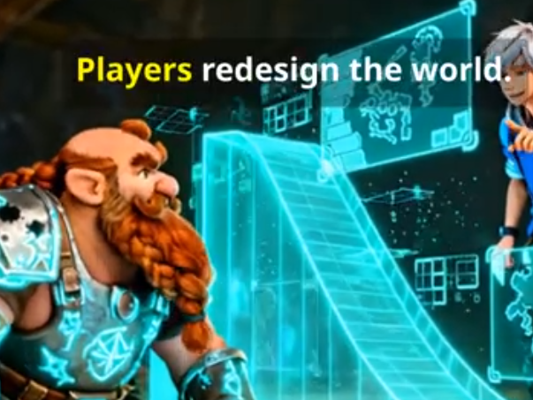
Core Gameplay Loop
Party Formation
  Barrier Discovery
  Systems Analysis
  Redesign Implementation
  NPC Validation
  Reflection & Empathy Growth
Notes:
The gameplay loop begins with party formation in a shared hub. Players discover barriers through exploration, analyze how they produce exclusion, collaboratively redesign the system, validate changes with NPCs, and reflect on what shifted. Reflection is embedded directly into progression.

Slide 5
Navigation-First Design
Movement reveals exclusion.
  Physical, sensory, informational, and temporal barriers
  Players redesign space, pacing, and communication systems
Notes:
Movement reveals exclusion. Navigation is the primary mechanic through which barriers emerge—terrain, overload zones, unclear signage, and rigid time constraints. Players redesign space, pacing, and communication systems, experiencing accessibility as infrastructure.

Slide 6
AI-Driven NPC Architecture
Convai-powered dialogue
  Trust + Overload variables
  Persistent memory tracking
  Multiplayer-synced emotional states
Notes:
NPCs are powered through an AI middleware layer integrated with Convai. Each character maintains persistent variables including trust, overload, and agency. Dialogue adapts based on player behavior and barrier state, creating a living social system.

Slide 7
Role-Based Cooperation
Navigator – Diagnoses access barriers
  Builder – Implements redesign
  Mediator – Validates with NPCs
  Analyst – Identifies systemic causes
  No single role can progress alone
Notes:
Players select from four roles: Navigator, Builder, Mediator, and Analyst. Each barrier transition requires specific role expertise. This structure ensures progress is impossible without cooperation, modeling collective responsibility.

Slide 8
Accessibility by Design
Captioning by default
  Adjustable pacing
  Cognitive load scaling
  Input remapping
  High contrast & motion reduction
Notes:
Accessibility is embedded into runtime systems, not layered on top. Captioning, adjustable pacing, cognitive load scaling, and motion reduction affect gameplay logic and UI complexity. The baseline assumes human variability.

Slide 9
Empathy & Reflection System
Barrier Recognition
  Systems Thinking
  Collaboration
  Respectful Communication
  Redesign Effectiveness
Notes:
Empathy is measured across barrier recognition, systems thinking, collaboration, respectful communication, and redesign effectiveness. Player actions generate measurable growth. Reflection prompts anchor learning transfer beyond gameplay.

Slide 10
Technical Architecture
Unity 6 + Netcode (server-authoritative)
  AI middleware layer
  Cloud persistence
  Scalable modular systems
Notes:
Built in Unity 6 with Netcode for GameObjects, the system uses a server-authoritative architecture. Barrier states, NPC variables, and empathy scores are validated server-side and synchronized across clients. AI flows through a middleware layer with guardrails.

Slide 11
Impact
Individual systems literacy growth
  Shared responsibility reinforcement
  Scalable for education and workforce contexts
  Accessibility normalized as infrastructure
Notes:
Impact operates at individual, social, and institutional levels. Players develop systems-based understanding of exclusion. Multiplayer reinforces shared responsibility. The project scales to education and workforce contexts.

Slide 12
Alignment
Inclusive design principles
  Ethical AI integration
  Digital equity frameworks
  Global accessibility initiatives
Notes:
The project aligns with inclusive design principles, ethical AI integration, digital equity frameworks, and global accessibility initiatives. It demonstrates how immersive technology can responsibly address structural bias.

Slide 13
Production Status
Multiplayer architecture implemented
  Role-gated systems functional
  NPC AI integration operational
  Empathy tracking active
  Vertical slice playable
Notes:
The vertical slice architecture is implemented. Multiplayer synchronization, role gating, NPC AI integration, empathy logging, and reflection systems are functional. The project has moved beyond concept into playable validation.

Slide 14
Roadmap
Phase 1: Vertical Slice Polish
  Phase 2: District Expansion
  Phase 3: Pilot Deployments
  Phase 4: Public Release
Notes:
Next phases include vertical slice polish, expanded districts, pilot deployments, and broader release. Each stage maintains technical rigor and inclusive design fidelity.

Slide 15
Impact Metrics Framework
Pre/Post Systems Literacy Assessment
  Empathy Score Growth (5-Dimension Model)
  Barrier Recognition Frequency
  Collaborative Action Tracking
  Qualitative Reflection Analysis
Notes:
Impact will be evaluated using a mixed-method framework. Quantitative measures include empathy score deltas across five domains and frequency of barrier recognition behaviors. Collaborative action logs track role-based contribution patterns. Pre- and post-engagement surveys assess systems literacy growth. Qualitative reflection analysis captures narrative evidence of shifted assumptions.

Slide 16
Institutional & Scalability Metrics
Pilot Deployment Adoption Rates
  Session Completion & Retention
  Multiplayer Collaboration Density
  Accessibility Feature Utilization
  Longitudinal Attitude Shift Tracking
Notes:
Institutional impact will be measured through pilot adoption rates, session completion metrics, and sustained multiplayer engagement. Accessibility feature utilization data will inform design refinement. Longitudinal studies will examine persistence of systems-thinking gains beyond gameplay exposure.

Slide 17
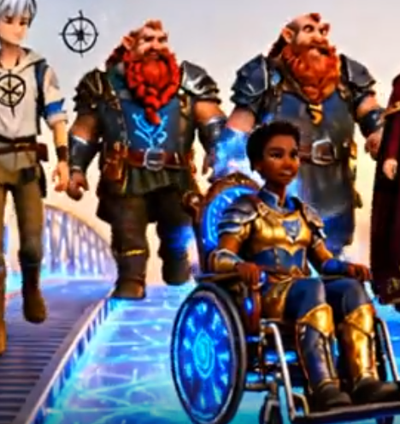
Belonging Is Designed
Accessibility is shared infrastructure.
  Systems can be redesigned.
  Common Ground Online builds inclusive worlds together.
Notes:
Belonging is not discovered—it is designed. Common Ground Online transforms systemic exclusion into collaborative redesign, reframing accessibility as shared infrastructure built together.

Slide 18
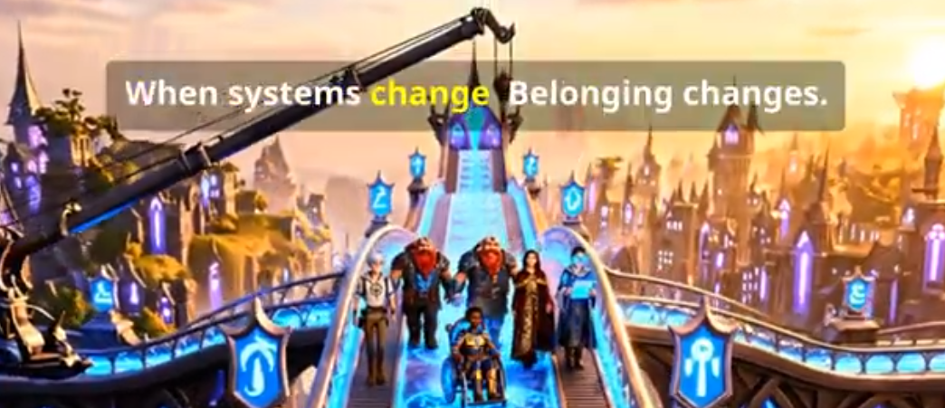

Alignment with UN Sustainable Development Goals
SDG 4 – Quality Education
SDG 10 – Reduced Inequalities
SDG 11 – Sustainable Cities & Communities
SDG 16 – Peace, Justice & Strong Institutions

